Slide 1

Team Work of Python Project

Slide 2
Date & Work
20/9/21
26/9/21 – 27/9/21
Deployment
Collection of Row data & Discussion About project
Creation of flow Chart , Algorithms & Coding
21/9/21 - 25/9/21
28/9/21
Testing & Finishing

Slide 3
Yashraj
Billing Section
Atharva
Appointment Section
Shreyas
Patient Section
Abhishek
Services Section
Harsh
Log In & Log out Section
Team Work

Slide 4
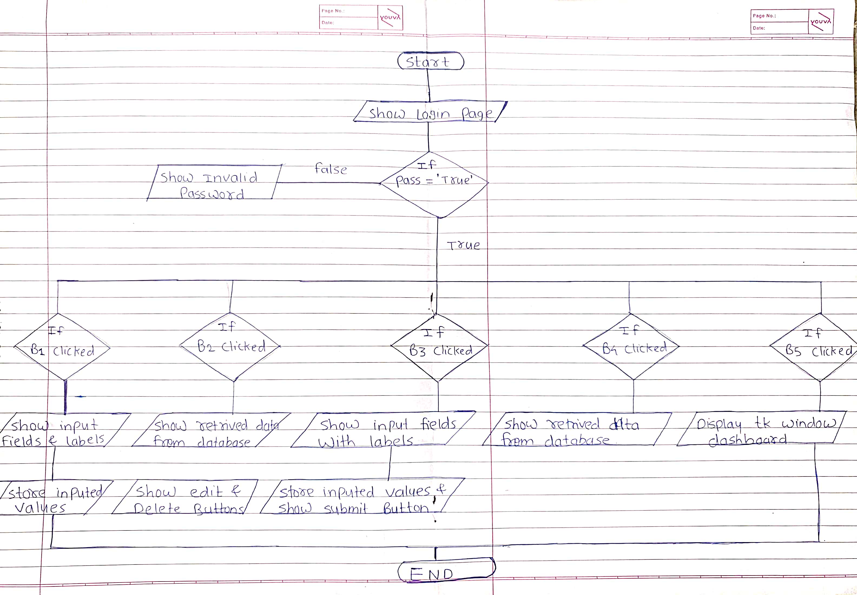

Slide 5
